Slide 1
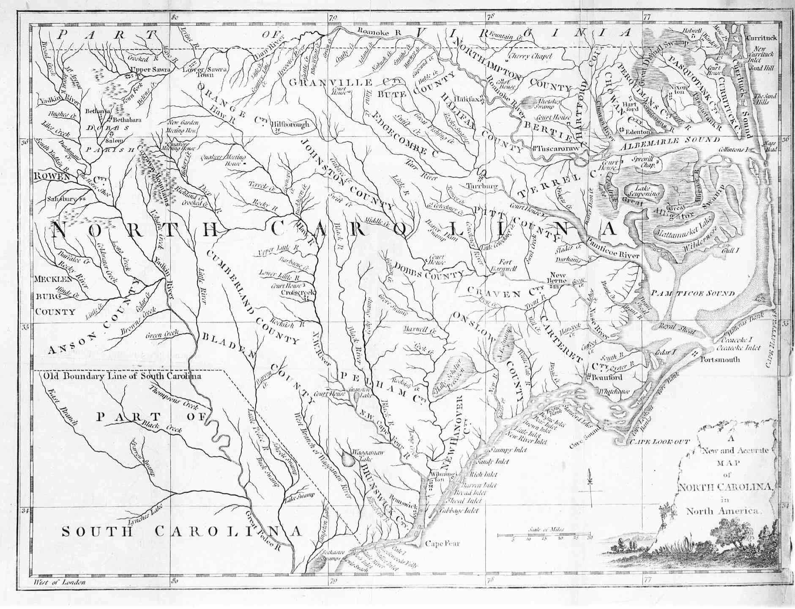
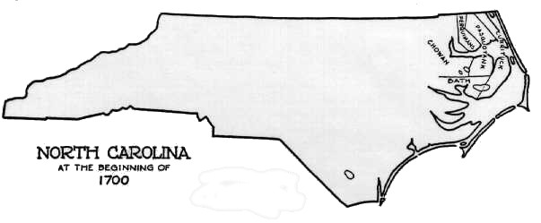
Early Kirk’s appearing in North Carolina
1697 - 1758
1697 – Kirk, Obediah of Stanly County Albemarle Township
1713 – Kirk, William of Craven County
1716 – Kirk, Thomas of Chowan County
1755 – Kirk, Joseph of Granville County (then to Orange and Chatham in1763)
1758 – Kirk, George of Granville County (then to Chatham in 1768)
1714, Sep 4th
Pasquotank Precinct Stephen Scott 230 acres joining Thomas Kirk.
1716, Oct 9th
Chicconamack Sandy Banks John Kerk 184 acres joining William Land and a Marsh.
North Carolina

Slide 2
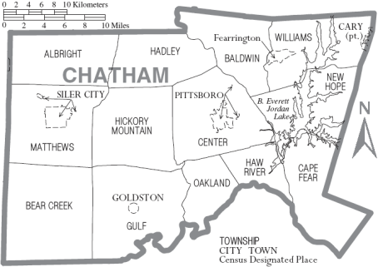
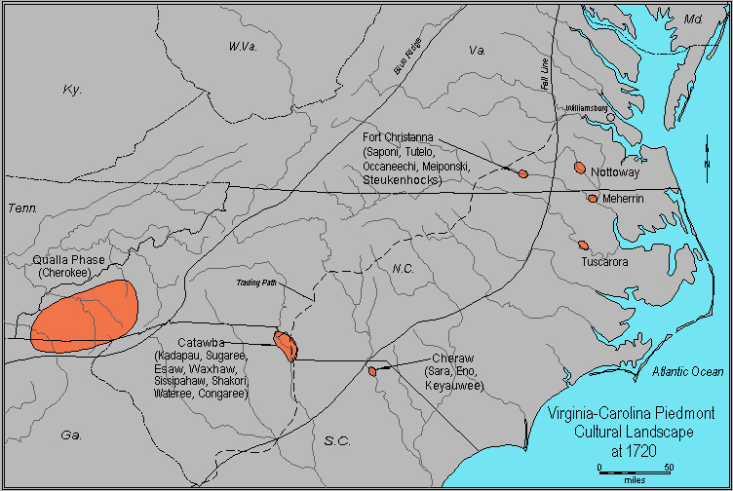
North Carolina 1763
1763 – Joseph Kirk listed in Chatham County, NC.

Slide 3
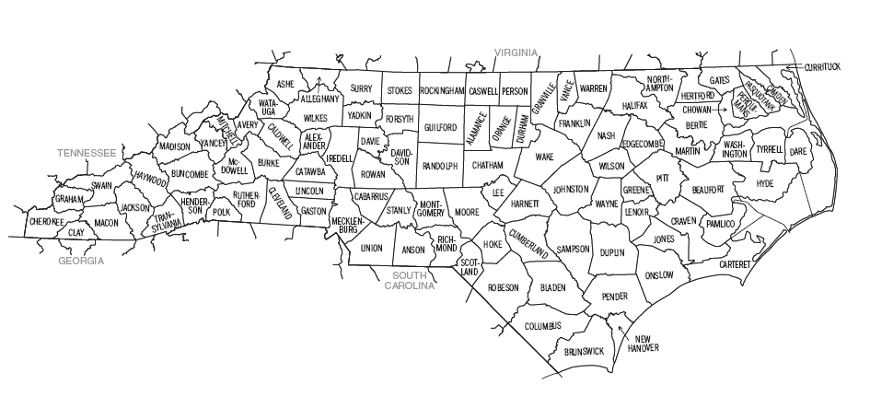
1758 – George Kirk listed in Granville County, NC.
1755 – Joseph Kirk listed in Granville County, NC.
1760 – Joseph Kirk listed in Orange County, NC.
1763 – Joseph Kirk listed in Chatham County, NC.
1764 – John Kirk listed in Chatham County, NC.
1764 – Richard Kirk listed in Chatham County, NC.
North Carolina 1760-1764

Slide 4
1779 - 1787 – Stephen Kirk listed in Orange County, NC.
With Isaac Kirk and Lewis Kirk
1774 – John Minter and wife Elizabeth sell to Abraham Womack 120 acres of land in Chatham County, NC. along the North Side of Deep River. Abraham Womack and wife Judith (Minter) Womack sell same land in 1784. Abraham Womack moves to Hancock County, GA. January 1786.
1778 – George Kirk listed in Chatham County, NC. Died after December 1816
North Carolina 1774-1778

Slide 5
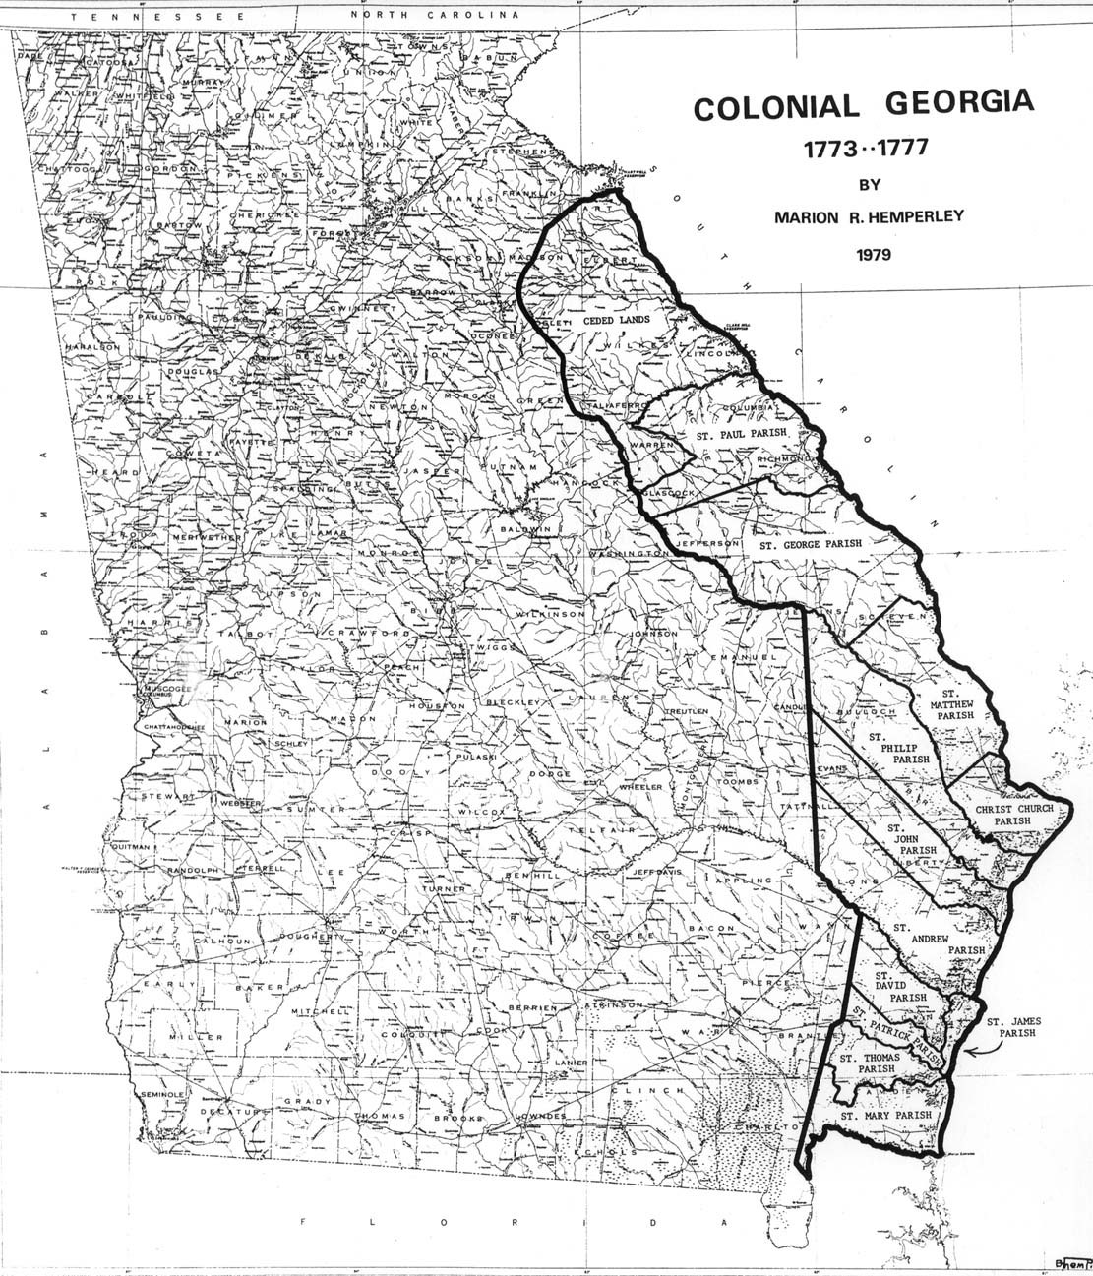
Georgia 1777
The TWO ACTS
For opening
a land office and for
the better settling
and strengthening
this State
1) 7 Jun, 1777
16 Sep, 1777 amended
2) 23 Jan 1780

Slide 6
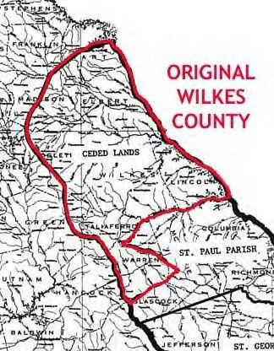
Georgia 1777
The TWO ACTS
For opening
a land office and for
the better settling
and strengthening
this State
1) 7 Jun, 1777
16 Sep, 1777 amended
2) 23 Jan 1780

Slide 7
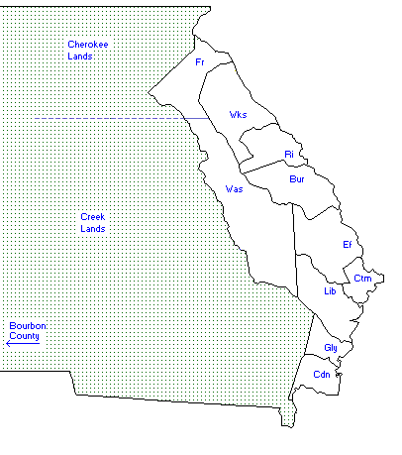
Georgia 1785
The Southern end of Franklin County
And the Northern portion of Washington
County (area of future Greene County)
was called bounty reserve or just
simply “RESERVE” land exclusively
for bounty grants to men who served in
the Continental Line or Navy (not citizens, refugees or militiamen)
Reference Georgia
Head-Right and Bounty
Grants Act of
Jan 23, 1780
Feb 17, 1783 (1st Effective Act)
Feb 25, 1784 (to open Franklin + Wash)
Feb 22, 1785 (enacted for the abuse)
Original Grant Dated
5 October 1785
200 acres without
the extra 50 acres for
each family member
suggests that both
John Kirk and Joseph Kirk
were out of state
and bachelors receiving
the land free of charge
at the time of the Grant.
Reference Georgia
Head-Right and Bounty
Grants Act of
Jan 23, 1780
Feb 17, 1783
Feb 25, 1784
Feb 22, 1785
1785 – John Kirk Head Right Renewed 200 acres Washington County, GA. on 5 Apr 1785.
1785 – Joseph Kirk Head Right Land Warrants 200 acres Hancock County, GA.
1786 – Abraham Womack moves to Hancock County, GA. (Greene?)
1786 – Abraham Womack of Greene County indenture from Henry Taylor for
1 negro and 287 ½ acres of land in Greene County. Witness John Kirk. 30 Aug 1786

Slide 8
Georgia 1787
The Southern end of Franklin County
And the Northern portion of Washington
County (area of future Greene County)
was called bounty reserve or just
simply “RESERVE” land exclusively
for bounty grants to men who served in
the Continental Line or Navy (not citizens, refugees or militiamen)
Reference Georgia
Head-Right and Bounty
Grants Act of
Jan 23, 1780
Feb 17, 1783 (1st Effective Act)
Feb 25, 1784 (to open Franklin + Wash)
Feb 22, 1785 (enacted for the abuse)
Original Grant Dated
5 October 1785
250 acres (extra 50 acres
for each family member)
suggests that John Kirk
was now married
and receiving
the land free of charge
at the time of the Grant.
Reference Georgia
Head-Right and Bounty
Grants Act of
Jan 23, 1780
Feb 17, 1783
Feb 25, 1784
Feb 22, 1785
1787 – Aug 6, John Kirk Head Right Land 250 acres Washington County, GA.
adjoining Thomas Hill and Brantley.

Slide 9
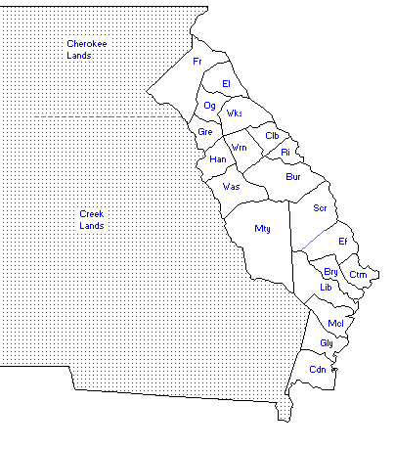
1790 – 14 Aug: George Kirk of Montgomery County, N.C. buys 400 acres of land in Greene County for $300 and sells it in 1793 to Edmond Carnes for 3 shillings.
Georgia 1790
Original Grant Dated
5 October 1785
1790 – John Doggett and Anne Garner sell plantation in Virginia and move large family to Columbia County (between Richmond and Wilkes) John dies here in 1804.
Reference Georgia
Head-Right and Bounty
Grants Act of
Jan 23, 1780
Feb 17, 1783
Feb 25, 1784
Feb 22, 1785
1790 - Asa Doggett (son) is
20 years old and marries
Elizabeth Eubank in 1803

Slide 10
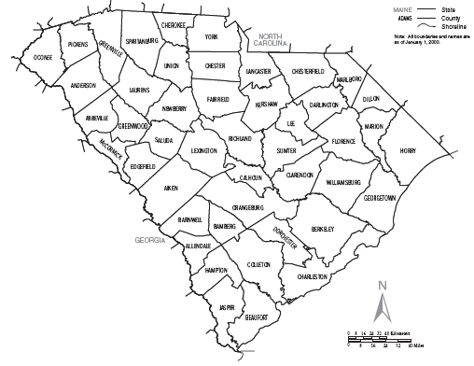
South Carolina 1790
1790 – Stephen Kirk appears in Census for York County, S.C.
1798 – Stephen Kirk appears in Census for Chester County, S.C.

Slide 11
1793 – 20 Feb: Abraham Womack and his wife Martha of Greene County sell to Mansel Womack of Wilkes County 150 acres of land in Wilkes County for 150 pounds.
Georgia 1793
Original Grant Dated
5 October 1785
Reference Georgia
Head-Right and Bounty
Grants Act of
Jan 23, 1780
Feb 17, 1783
Feb 25, 1784
Feb 22, 1785

Slide 12
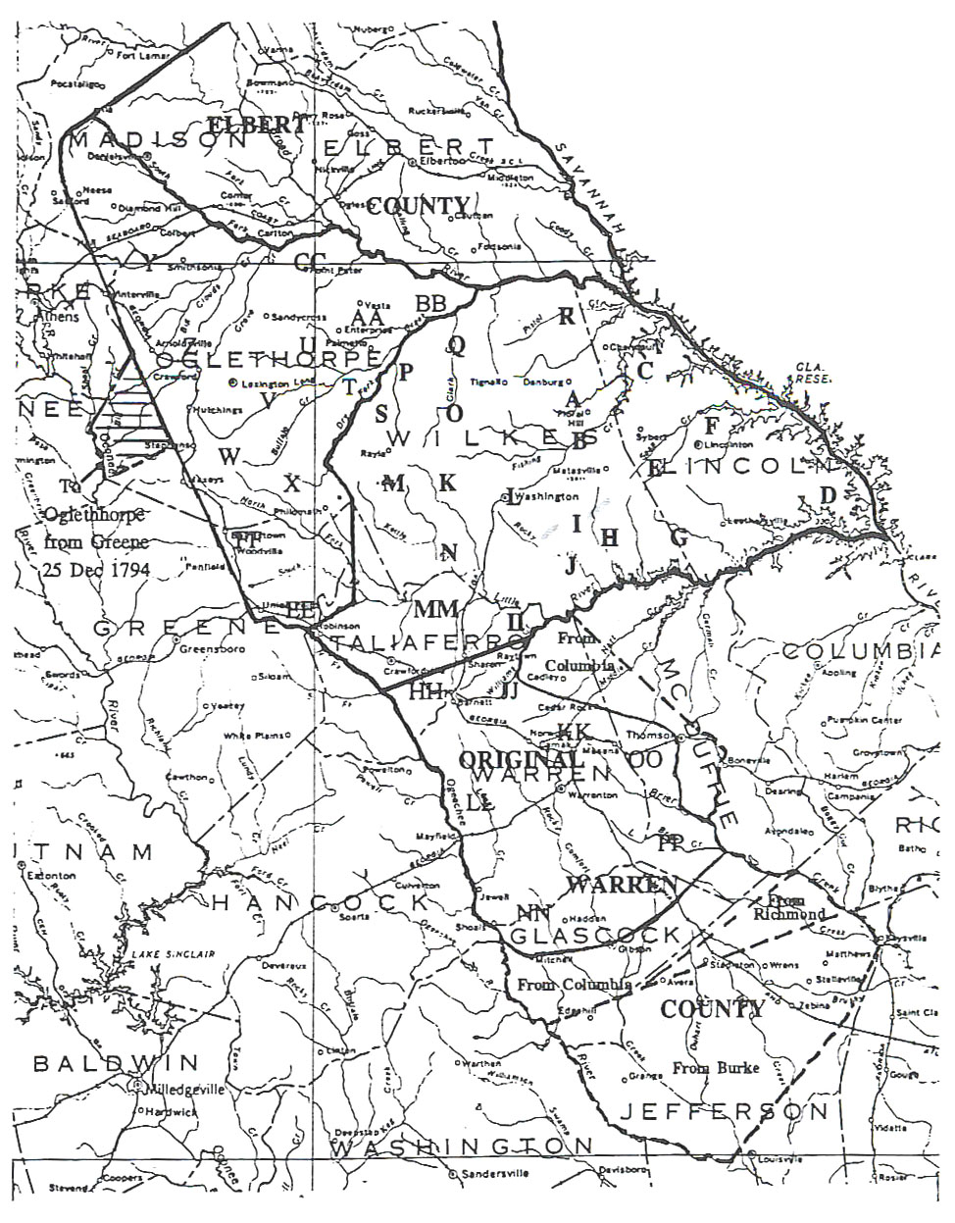
1790 – John Doggett and Anne Garner sell land in Virginia and move large family to Columbia County (between Richmond and Wilkes) John dies here 1804.
Georgia1794 tax digest
1794 – Joseph Kirk listed in Hancock County, GA.
1794 – John Kirk listed in Hancock County, GA.
Owning Land along the waters of Little Ogeechee River and Williamson Swamp.
1794 – Issac Kirk listed in Hancock County, GA.
Purchased 300 acres of land along the waters of Beaverdam.
1794 – Stephen Kirk listed in Hancock County, GA.
1794 – Abraham Womack listed in Hancock County, GA.
1794 – Joel McClendon listed in Hancock County, GA.
Owning Land along the waters of Fort Creek bordering the mouth of Rocky Creek

Slide 13
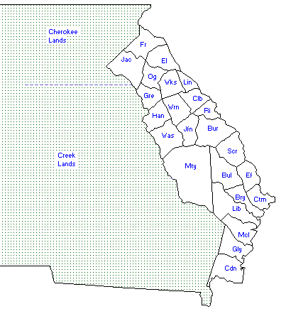
Georgia 1796
1796 – Jesse Kirk listed in Hancock County, GA.
Yazoo Land Fraud
7 January 1795
Yazoo Land Act
Recinded
18 February 1796
Owning Land along the waters of the Ogeechee
1796 – Stephen Kirk marries Elizabeth McClendon, daughter of Joel McClendon in Hancock County, GA.

Slide 14
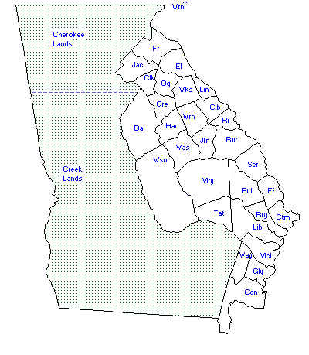
Georgia 1804
Baldwin and Washington
Counties open up for the 1805
Georgia Land Lottery followed
by a great deal of buying and selling.
Tax Rolls
John Kirk – Jackson
John Kirk Sr. – Jackson
John Kirk Jr. – Jackson
Stephen Kirk – Hancock

Slide 15
Georgia 1805
Henry Kirk (1 draw)
James Kirk (1 draw)
Jesse Kirk (1 draw)
John Kirk Senior (1 draw)
John Kirk Junior (1 draw)
Stephen Kirk (1 draw)
Thomas Kirk (2 draws)
Abner Womack (1 draw)
Abraham Womack (1 draw)
David Womack (1 draw)
Edmond Womack (1 draw)
Robert Womack (1 draw)
Georgia Land Lottery1805
Entitled to Draw
Fortunate Drawers
Aaron Hunt (1 draw)
Benjamin Hunt (1 draw)
Charles S. Hunt (1 draw)
Chloe Hunt (widow) (1 draw)
Curtis Hunt (1 draw)
Daniel Hunt (1 draw)
Fitz M. Hunt (1 draw)
George Hunt (1 draw)
George M. Hunt (1 draw)
Henry Hunt (3 draws)
James Hunt (4 draws)
James, Jesse, William Hunt (1 draw)
Jesse Hunt (1 draw)
Joel Hunt (2 draws)
John Hunt (2 draws)
Judkins Hunt Junior (1 draw)
Judkins Hunt Senior (1 draw)
Litteton Hunt (1 draw)
Moses Hunt (1 draw)
Nathaniel Hunt (2 draws)
Nathaniel Hunt Senior (1 draw)
Richardson Hunt (1 draw)
Thomas Hunt (2 draws)
Turner Hunt (1 draw)
William Hunt (3 draws)
William Hunt (1 draw)
Willm. Hunt (1 draw)
Amos McClendon (orphans of) (1 draw)
Beniah McClendon (1 draw)
Dennis McClendon (2 draws)
Francis McClendon (1 draw)
Isaac McClendon (2 draws)
Jacob McClendon (1 draw)
Job McClendon (1 draw)
Joel McClendon Esq. (1 draw)
Josiah McClendon (1 draw)
Lewis McClendon (1 draw)
Louisa McClendon (widow) (1 draw)
Loven S. McClendon (1 draw)
Marble McClendon (1 draw)
Mark McClendon (1 draw)
Martin McClendon (1 draw)
Mason McClendon (1 draw)
McClain McClendon (1 draw)
Samuel McClendon (1 draw)
Stanley McClendon (1 draw)
Thomas McClendon (2 draws)
William McClendon (3 draws)
Willis McClendon (1 draw)
Wilson McClendon (1 draw)
Asa Doggett (1 draw)
Garner Doggett (1 draw)
Jesse Doggett (1 draw)
John Doggett Junior (1 draw)
John Doggett Senior (1 draw)
Reuben Doggett (1 draw)
William Doggett (1 draw)

Slide 16
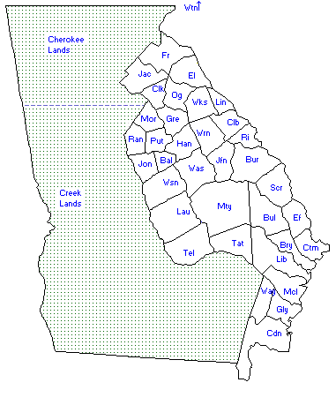
Georgia 1807-1811
Ephraim McClendon
Lovin S. McClendon
Nancy McClendon
Georgia Land Lottery1807
Fortunate Draws
10 Dec 1807
Jones County is Created.
Jesse Kirk
William Kirk
Abraham Womack
Jacob Womack
John H. Womack
Mansel Womack
Richard Womack
Robert Womack
Fitz M. Hunt
Henry Hunt
John Hunt
Littleton Hunt
Michael C. Hunt
Rebecca Hunt (widow)
Thomas Hunt
William Hunt
1807 – Stephen Kirk buys land in Baldwin County, Ga.
1808 – Stephen Kirk buys land in Baldwin County, Ga.
1808 – Stephen Kirk buys land in Baldwin County, Ga.
Asa Doggett (son of John)
Chatten Doggett
Thomas Doggett
1809 – Stephen Kirk buys land in Jones County, Ga.
1807 – 28 October: Asa Doggett is granted land in Baldwin County, Ga. then sells it to John Doggett for $2000 on 2 March 1808.
1810 – Stephen Kirk buys and sells land in Jones County, Ga.
1811 – Stephen Kirk buys land in Jones County, Ga.
1808-1814 – Stephen Kirk appears on page 57 in Jones County, Ga. Ordinary Court Minutes.

Slide 17
Georgia 1813
Tax Rolls
1813 – John Kirk Junior moves from Jackson County, Ga. to Jones County, Ga.
John Kirk – Jackson
John Kirk Sr. – Jackson
John Kirk Jr. – Jackson
Stephen Kirk – Hancock
1813 – 20 Nov: John Kirk applies for marriage license marries Mary Reeves 21 Nov 1813.

Slide 18
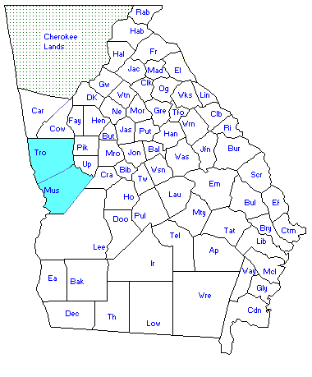
Georgia 1819-1826
Georgia Land Lotteries
1820 (3rd )
1821 (4th )
1827 (5th )
1832 (6th )
1832 (7th or Gold)
1833 (8th)
1820 – 14 Aug: John Kirk marries Barsheba Tyler in Greene County, GA.
1819 – 22 Dec: John Kirk applies for marriage license and marries Lucy Ellington Hendricks on 23 Dec 1819.
1825 – Mar 4: William Kirk marries Menefer Huldah in Monroe County, GA.

Slide 19
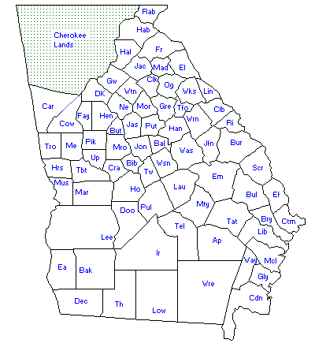
Georgia 1827
Georgia Land Lotteries
1820 (3rd )
1821 (4th )
1827 (5th )
1832 (6th )
1832 (7th or Gold)
1833 (8th)
1827 – Aug 10: Joseph Kirk (solider) living in Henry County pays as a fortunate drawer on 22 Dec 1828 for a land grant from the Muscogee Land Grant 1827-1852.

